Slide 1

Stinger
Just Shoot Me
JavaScript UI and DOM Teamwork

Slide 2

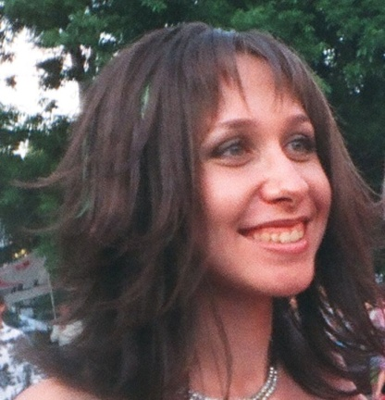
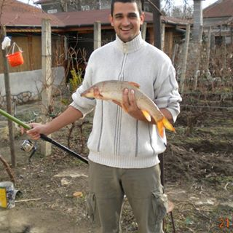
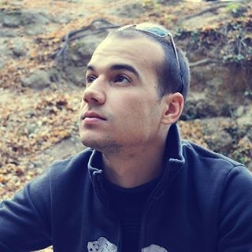

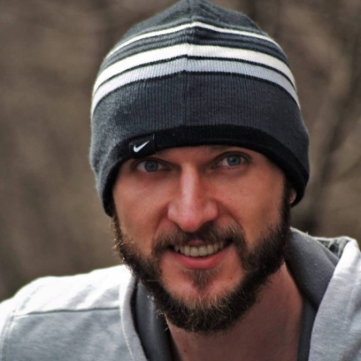
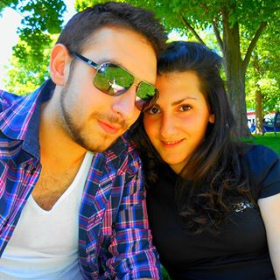
Stinger Team
Zlatka Todorova
Petya Kostova
Plamen Paunov
Tomi Hristov
zlatka.todorova
pepsi_555
Puncky
tomi.hristov.5
Tito Titov
Marto Veshev
Nikolay Atanasov
tito_t
vesheff
ni4ka7a

Slide 3
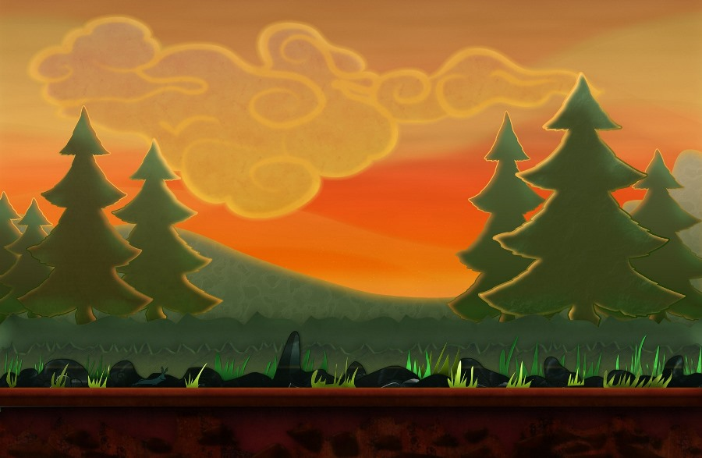
Game description
Game Rules
Points system
Features

Slide 4
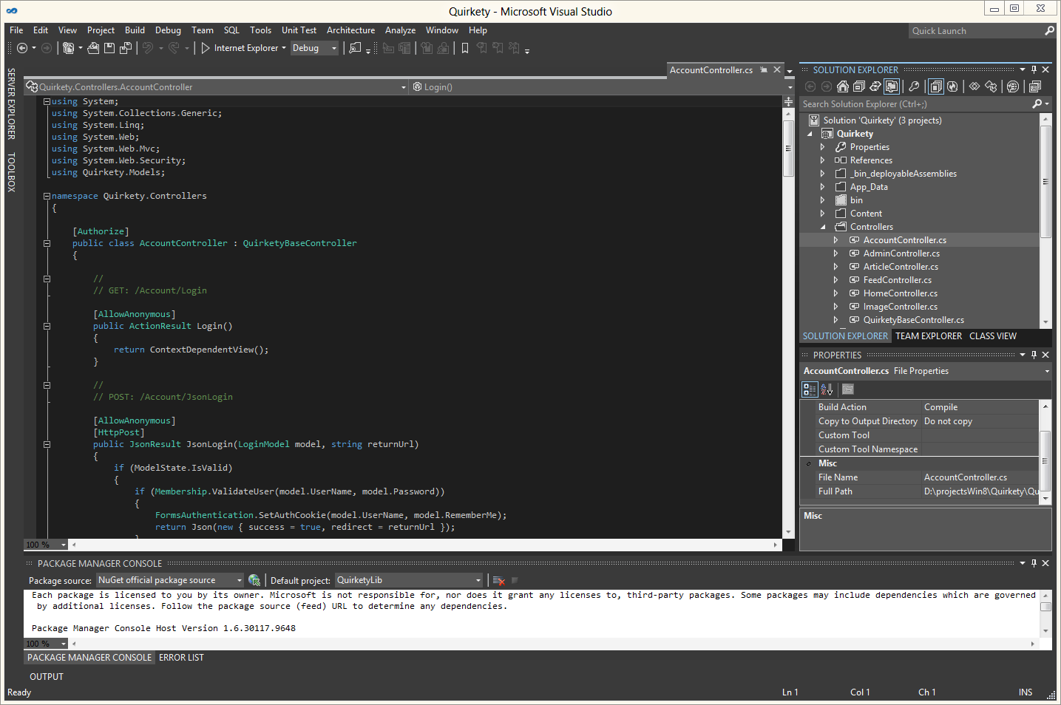
Code Demo

